Slide 1

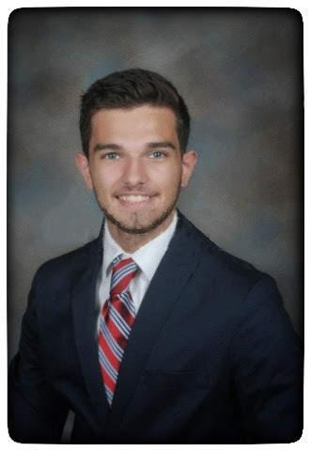
The Cancer Genome Atlas
Kidney Clear Cell Carcinoma
ECE 4783 - Module 1 and 2 Feedback
Alex Faché and Sam Lovejoy, UG 2
Tuesday March 10, 2020

Slide 2
Content
Clinical Problem Statement
Literature Critique
Flow Chart
Module 1
Preprocessing
Module 2
Feature Selection
Feature Extraction
Project Timeline and Contribution
References

Slide 3
Clinical Problem Statement
to develop a decision support model for diagnosis and prognosis of cancer
follow image processing pipeline for clinical decision making
1 - Image Processing
using "quality controlled" images, apply normalization and data augmentation
2 - Image Feature Extraction
extract color, texture, and morphological features from images
3 - Image Classification for Clinical Decision Making
develop models for three classifier techniques, apply two cross-validation schemes, analyze four performance metrics for each predictive model

Slide 4
Literature Critique: Alex
Automatic Batch-Invariant Color Segmentation of Histological Cancer Images¹ | Automatic Classification for Pathological Prostate Images Based on Fractal Analysis² | Mitosis detection in breast cancer pathology images by combining handcrafted and convolutional neural network features³
color normalization | texture features | morphological features
Sonal Kothari, John H. Phan, Richard A. Moffitt, Todd H. Stokes, Shelby E. Hassberger, Qaiser Chaudry, Andrew N. Young, May D. Wang | Po-Whei Huang, Cheng-Hsiung Lee | Haibo Wang, Angel Cruz-Roa, Ajay Basavanhally, Hannah Gilmore, Natalie Shih, Mike Feldman, John Tomaszewski, Fabio Gonzalez, Anant Madabhushia
2011 | 2009 | 2014
Conf Proc IEEE Int Symp Biomed Imaging | IEEE Transactions on Medical Imaging, Vol 28, No 7, July | Journal of Medical Imaging
normalize over color map instead of all pixels selects unique colors does not include frequency of colors | fractal based feature set is more accurate than feature sets from multiwavelets, Gabor filters, GLCM | cascaded strategy of CNN with handcrafted features faster approach and far less computationally expensive
all pixel normalization tends to distort colors more in the normalized image | Gleason grading is based on texture properties apply fractal dimension to analyze texture is well suited | light CNN that is less computationally expensive difficult to detect mitotic nuclei due to highly variable size and shape
use expert domain knowledge to increase overall performance of color segmentation | fractal dimension feature set of small size that effectively grades prostate images according to Gleason grading methods used are differential box-counting and entropy-based fractal dimension estimation | mitosis detection is one of 3 key factors in breast cancer grading existing methods used either handcrafted features or CNN
Notes:
Automatic Batch-Invariant Color Segmentation of Histological Cancer Images¹
normalize images to reduce sensitivity to batch effects
problem because of variations in specimen preparation, staining, imaging
supervised more accurate than unsupervised for automatic segmentation methods
batch effect
observed differences in colors among images
histogram normalization
use color map to normalize images because normalizing over all pixels distributions tends to distort colors in the normalized image
extract unique colors in the image
does not include frequency of colors
Automatic Classification for Pathological Prostate Images Based on Fractal Analysis
automatically grade pathological images according to Gleason grading system of prostate tissues
feature extraction using fractal dimension
methods
differential box-counting
entropy-based fractal dimension estimation
Mitosis detection in breast cancer pathology images by combining handcrafted and convolutional neural network features
combines CNN model with handcrafted features
CNN
more complex and requires large number of labeled training instances
Bloom Richardson grading
used for histopathological diagnosis of invasive breast cancers
tubule formation
nuclear pleomorphism
mitotic count

Slide 5
Literature Critique: Sam
Object-and spatial-level quantitative analysis of multispectral histopathology images for detection and characterization of cancer | Automated classification of brain tumor type in whole-slide digital pathology images using local representative tiles | Histological image feature mining reveals emergent diagnostic properties for renal cancer
All three, but mostly morphological | Texture features | Multiple
L. Boucheron | J. Barker, A. Hoogi, A. Depeursinge, D. L. Rubin | S. Kothari, J. H. Phan, A. N. Young, and M. D. Wang
2008 | 2016 | 2011
PhD Thesis UC Santa Barbara | Medical Image Analysis | IEEE Bioinformatics Biomedicine
Used multispectral analysis over RGB analysis for object recognition, attempts to classify breast cancer histopathology images using a known dataset from Yale University | Examines coarseness versus fineness in localized regions of brain tumor images for differentiation among cancer subtypes. | Color features come from 28 unique Gabor filters each with energy E and entropy H for square cropped subregions of renal cancer images.
This thesis did not implement feedback loops, there was no recursion in pixel-level analysis for object recognition. | Uses color segmentation, texture, and morphological features in “tiles”, localized regions of whole slide (very large) images. | Texture features come from histograms using the eight fractal method. Eight statistics are used for each of 31 tiles plus the object length for a total of 249 texture features.
Non-nuclear features for feature extraction provided the most reliable results, though the algorithms were computationally expensive. No increases in accuracy. | The authors achieved an accuracy rating of between 95.5% and 100% for a dataset of 302 images using an elastic net classifier. | Shape and Topology features come from elliptical centers around the center nuclei and segmented stain objects. Other algorithms such as Voronoi diagram are used for topology features.

Slide 6
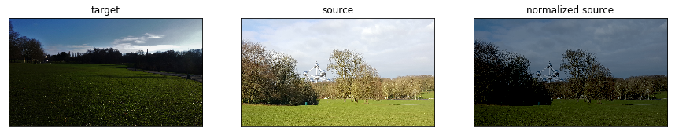
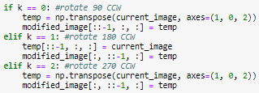
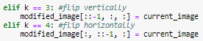
Module 1: Flow Chart
Reinhard's Method (normalization)
RGB → LAB
LAB → RGB
Cropping (224 x 224)
perform 5 crops per image
Rotating (90º, 180º, 270º)
perform 1 of each
Flipping (Vertical, Horizontal)
perform 1 of each
Notes:
Rubric Part III
Insight Gained
Using a test image that wasn't a tissue sample made it much easier to verify that the normalization step was working as expected
Problems Encountered
Initially when performing the rotating and flipping it was implemented to perform a random rotate and a random crop. Due to the matrix manipulation this often resulted in the same image being produce inadvertently. As Yuanda mentioned in lecture, we separated this process and performed a unique rotation and flip (5 possibilities) independent of one another on each cropped image.

Slide 7
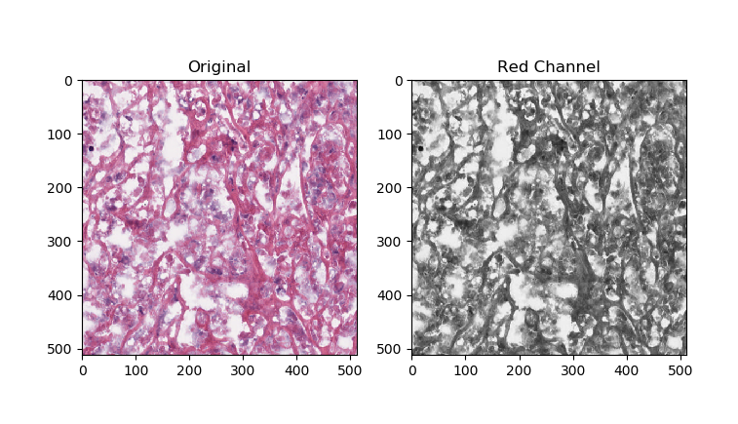
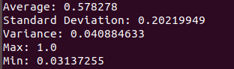
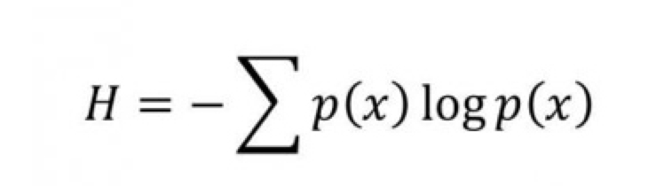
Module 2: Flow Chart
100 features
(color)
Red Channel
Red Statistics
Shannon Entropy
100 features (texture)
6.182
Notes:
Rubric Part III
Insight Gained
Using a test image that wasn't a tissue sample made it much easier to verify that the normalization step was working as expected
Problems Encountered
Initially when performing the rotating and flipping it was implemented to perform a random rotate and a random crop. Due to the matrix manipulation this often resulted in the same image being produce inadvertently. As Yuanda mentioned in lecture, we separated this process and performed a unique rotation and flip (5 possibilities) independent of one another on each cropped image.

Slide 8
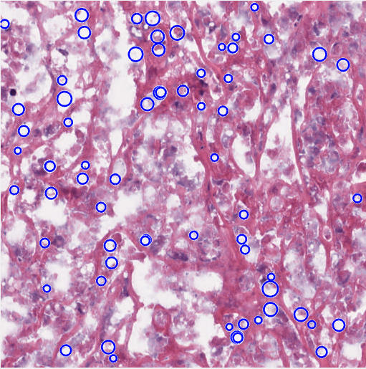
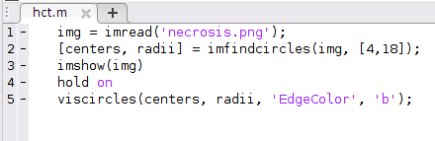
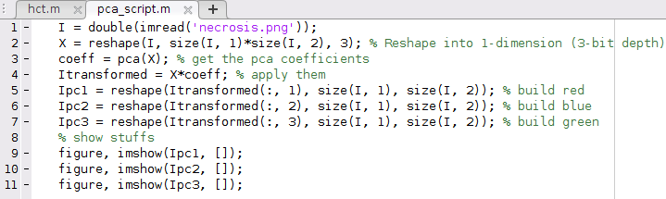
Module 2: Flow Chart
HCT
100 features (morphology)
PCA
Data Reduction Algorithm
Notes:
Rubric Part III
Insight Gained
Problems Encountered

Slide 9
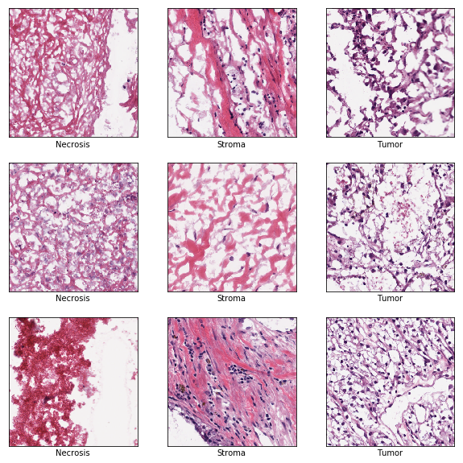
Original Data
Necrosis
premature death of cells
Stroma
healthy connective tissue cells
Tumor
abnormal cell divides uncontrollably destroying body tissue

Slide 10
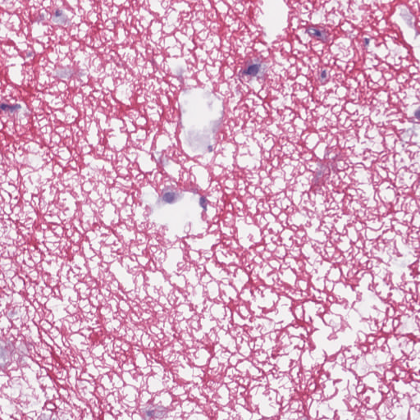
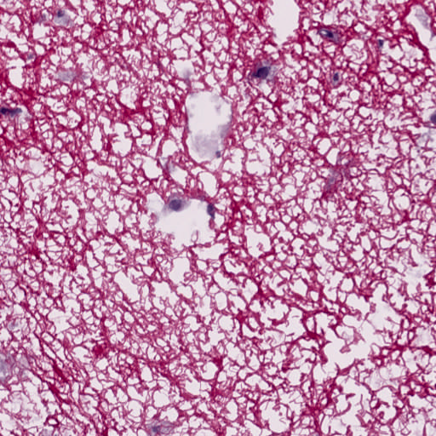
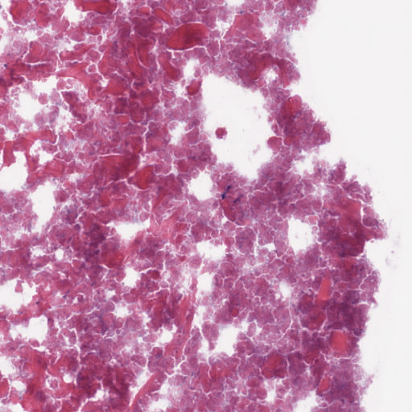
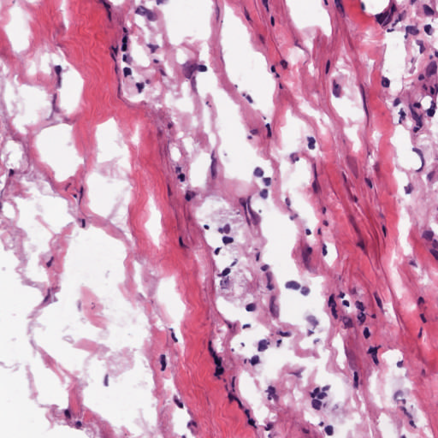
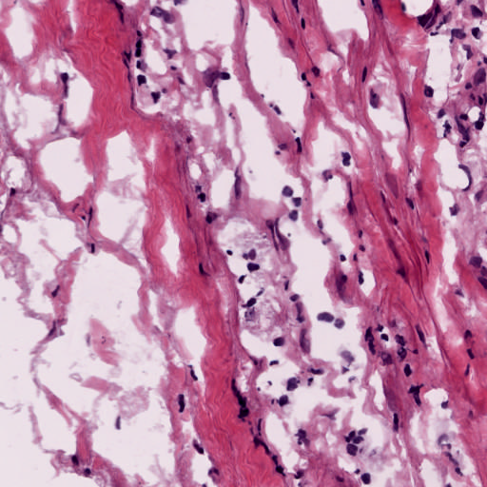
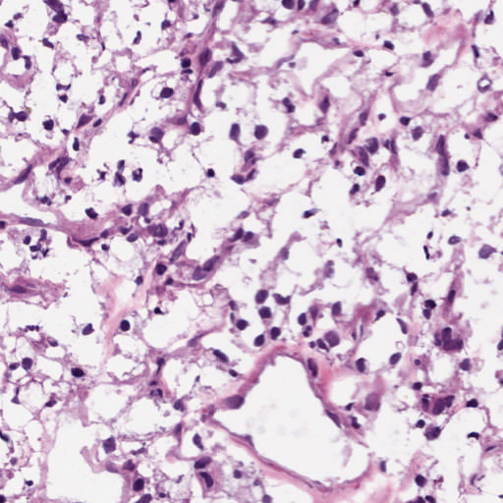
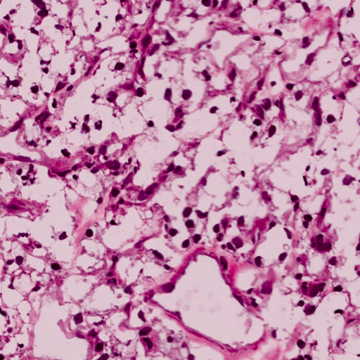
Preprocessing:
Necrosis Target
Normalized Source
Source
Target
Notes:
target - Necrosis 93
source - 10
normalized source - 2

Slide 11
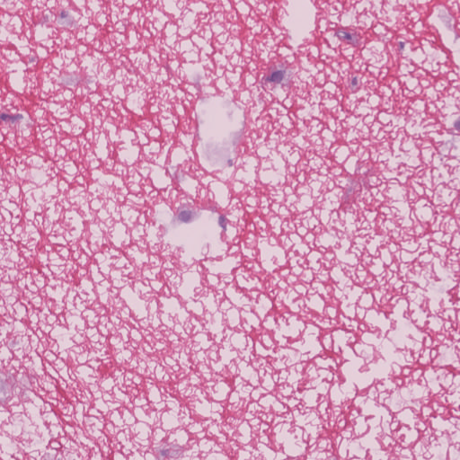
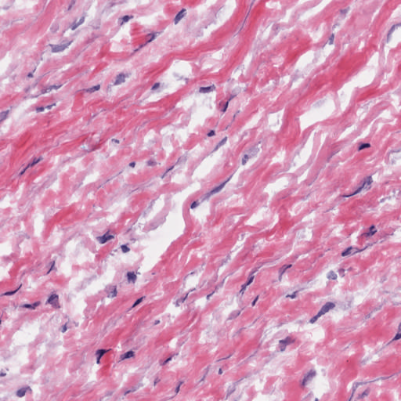


Preprocessing:
Stroma Target
Normalized Source
Source
Target
Notes:
target - Stroma 1
source - 10
normalized source - 1

Slide 12
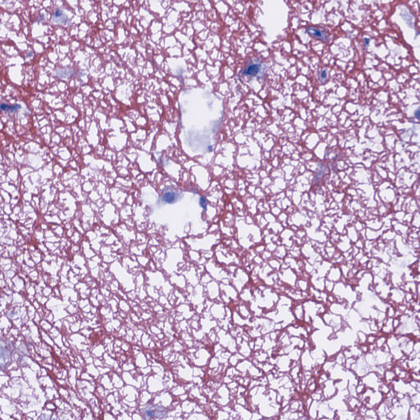
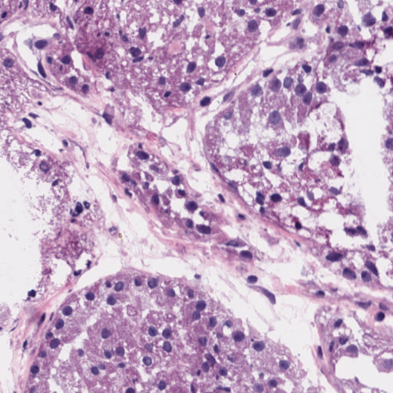
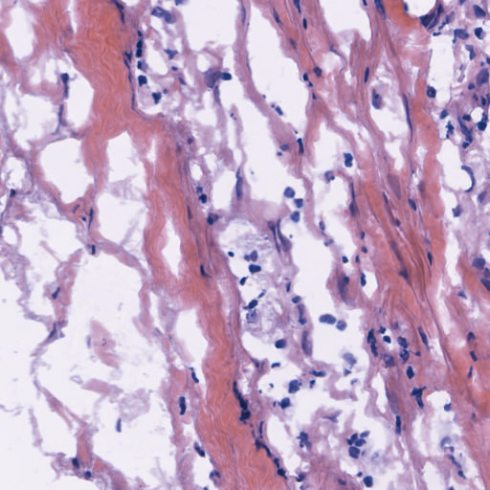
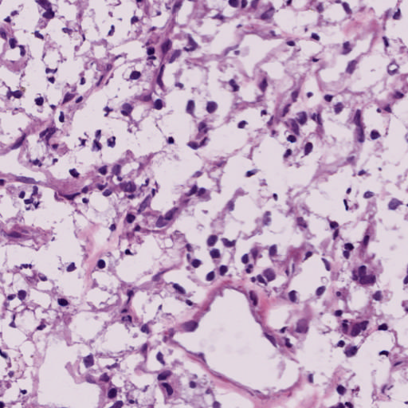
Preprocessing:
Tumor Target
Normalized Source
Source
Target
Notes:
target - Tumor 94
source - 10
normalized source - 2

Slide 13
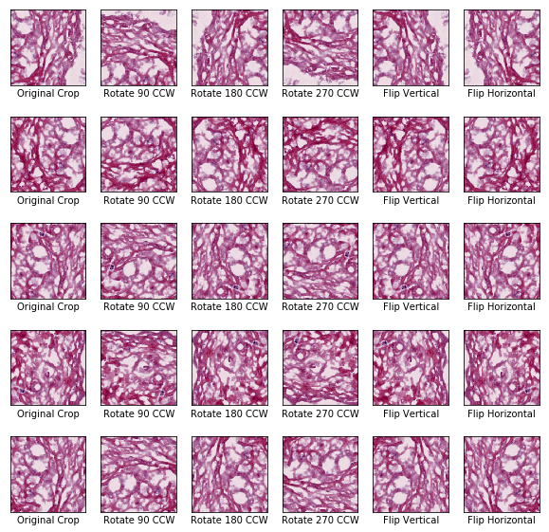
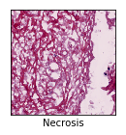
Preprocessing: Cropping, Flipping, Rotating

Slide 14
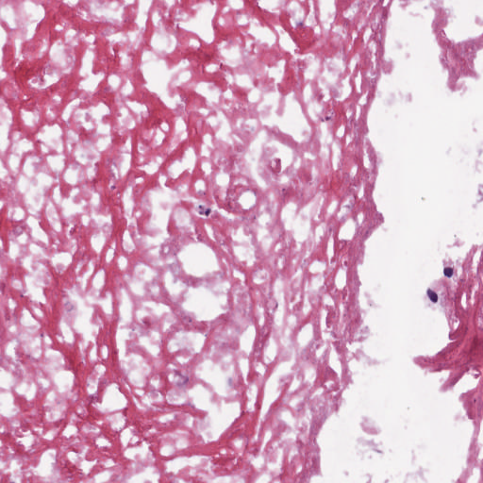
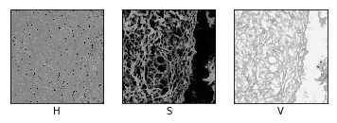
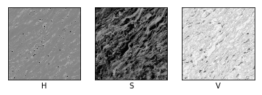
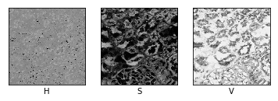
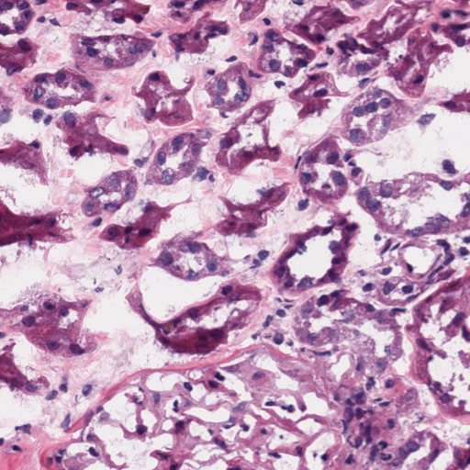
Feature Selection and Extraction - Color HSV
[0.04386097 0.03393478 0.04388783 0.00541669 0.02831175 0.00519455]
[0.04407357 0.03931944 0.04402243 0.00326273 0.02017689 0.00389242]
[0.04395115 0.03608433 0.0431277 0.00462836 0.0255156 0.00965021]

Slide 15
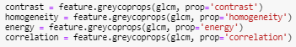
Feature Selection and Extraction - Texture GLCM
[0.33699545 0.34934375 0.35286507 0.35348353 0.10693018 0.05439614 0.02205111 0.00702876]
[0.32264647 0.348883 0.35213572 0.35340744 0.14456578 0.05727689 0.03162951 0.01015728]
[0.3376464 0.3502538 0.35295105 0.35349736 0.10485661 0.04819005 0.02062924 0.00629445]

Slide 16
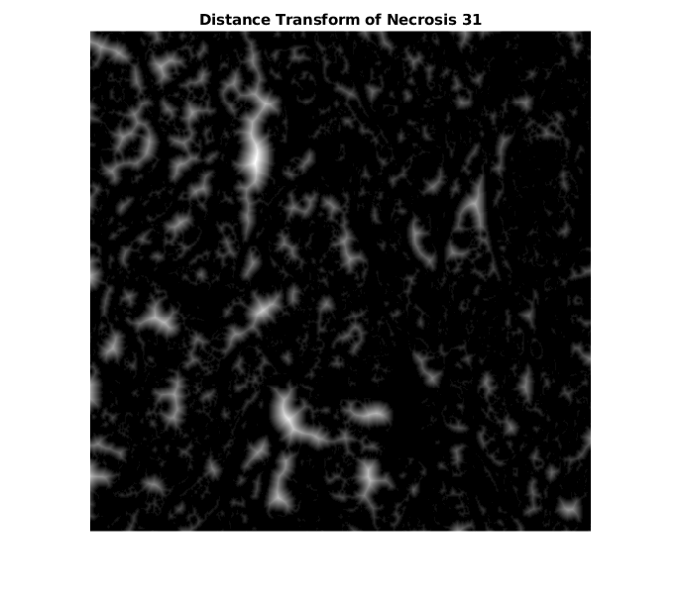
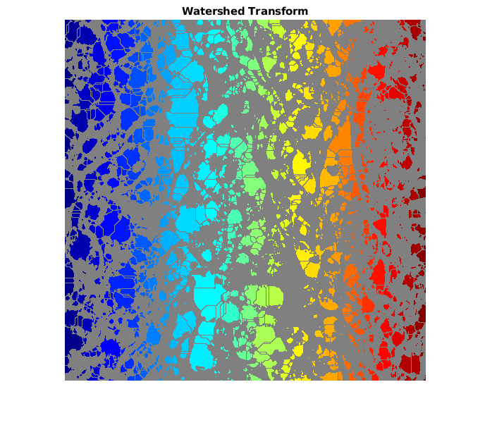
Feature Selection and Extraction - Morphological

Slide 17
Feature Selection and Extraction - Summary
Color | Texture | Morphological | Dimensionality Reduction
RGB (μ, 𝞂) | entropy | symmetry | Principal Component Analysis
HSI (μ, 𝞂) | contrast, homogeneity, energy, correlation | erosion | Random Forest sequential forward selection
LAB (μ, 𝞂) | nucleus density for subregions (μ, 𝞂) | dilation
 | nucleus shape (minor axis, major axis) | Watershed, Canny edge detection
 | DCT (μ, 𝞂) | SNR
 | DFT (μ, 𝞂) | noise mask
 | histogram analysis | edge eccentricity
 | Jaccard similarity index
 | Sørensen–Dice coefficient
 | Autoencoder
Notes:
RGB
HSI
LAB
entropy
how predictable the image is
contrast, homogeneity, energy, correlation
nucleus density for subregions
show if symmetry of image
nucleus shape
how it changes among classes
DCT
DFT
histogram analysis
Jaccard similarity index
Sørensen–Dice coefficient
Autoencoder
symmetry
is image symmetric
erosion
dilation
Watershed, Canny edge detection
SNR
noise mask
edge eccentricity
Principal Component Analysis
remove features with lowest variance
Random Forest sequential forward selection
determine features that provide highest accuracy

Slide 18
Project Timeline and Contribution
Module 1 and 2 Feedback
March 10, 2020
Module 2 Literature Review
March 12, 2020
Final Presentation and Report
April 6, 2020
Alex
Module 1
feature extraction
Sam
Module 2
100+ Feature extraction
PCA reduction and Image Compression
Autoencoder implementation
Notes:
Rubric Part IV
Timeline
Team Member Work Distribution

Slide 19
References
S. Kothari, J. H. Phan, R. A. Moffitt, T. H. Stokes, S. E. Hassberger, Q. Chaudry, et al., "Automatic batch-invariant color segmentation of histological cancer images," Conf Proc IEEE Int Symp Biomed Imaging, ISBI, pp. 657-660, 2011.
P. Huang and C. Lee, "Automatic Classification for Pathological Prostate Images Based on Fractal Analysis," in IEEE Transactions on Medical Imaging, vol. 28, no. 7, pp. 1037-1050, July 2009.
H. Wang, A.C. Roa et al, “Mitosis detection in breast cancer pathology images by combining handcrafted and convolutional neural network features". Journal of Medical Imaging, 1(3), 034003 (2014).
L. Boucheron, "Object-and spatial-level quantitative analysis of multispectral histopathology images for detection and characterization of cancer," PhD thesis, University of California, Santa Barbara, 2008.
J. Barker, A. Hoogi, A. Depeursinge, D. L. Rubin, "Automated classification of brain tumor type in whole-slide digital pathology images using local representative tiles," Medical Image Analysis, vol. 30, pp. 60-71, 2016.
S. Kothari, J. H. Phan, A. N. Young, and M. D. Wang, "Histological image feature mining reveals emergent diagnostic properties for renal cancer," Conf Proc IEEE Bioinform Biomed, BIBM, 2011.

